Slide 1
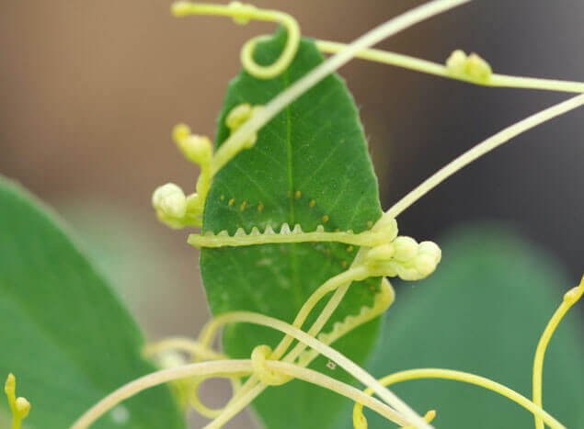
Plant signaling and hormones

Slide 2
Learning goal
Describe etiolation and de-etiolation in terms of environmental cues and growth responses

Slide 3
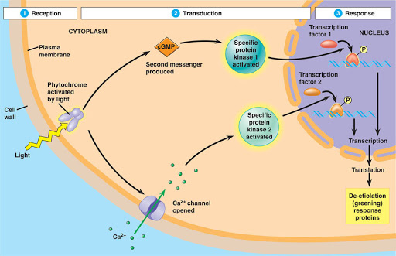
Signal transduction pathway
Reception - signals are detected by cell receptors
Transduction - signals are amplified and transferred to other proteins that carry out the response
Response - change in cellular activities

Slide 4
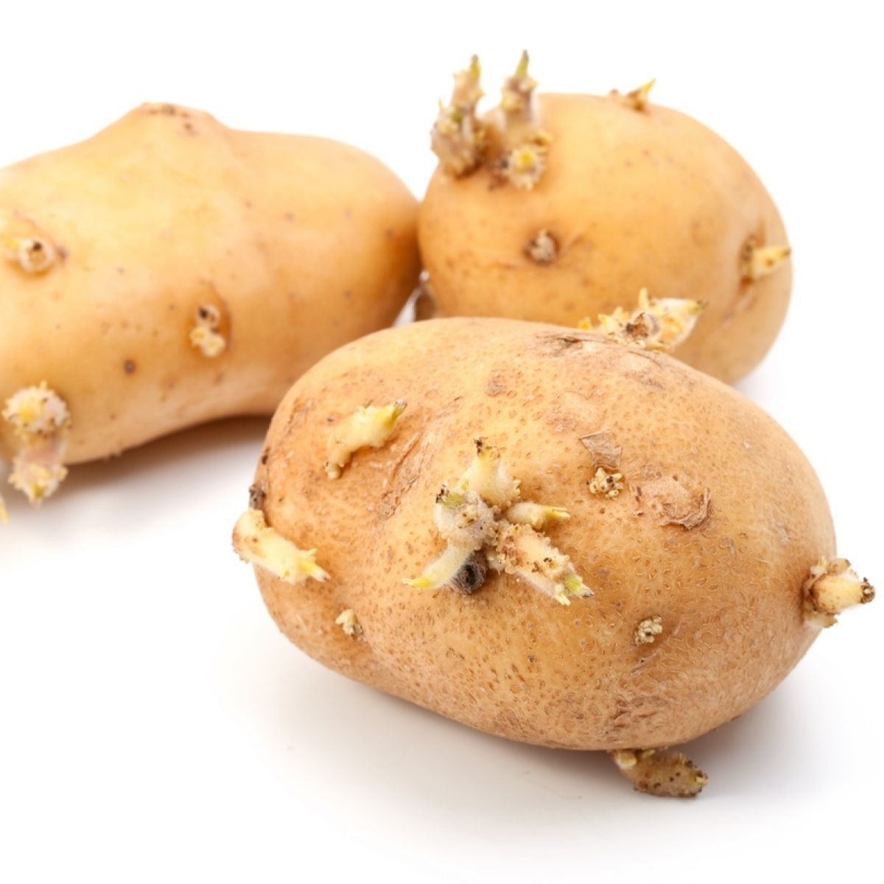
Example - a sprouting potato
Etiolation - process in flowering plants grown in partial or complete absence of light

Slide 5
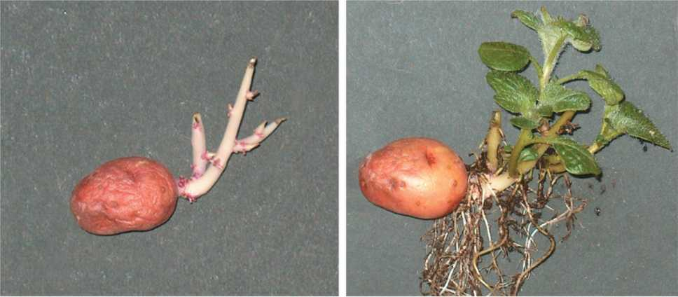
De-etiolation

Slide 6
Plant signaling and hormones

Slide 7
Learning goal
Describe the signal transduction pathway from signal to transduction to response, noting the processes that take place at each step

Slide 8
Signal reception
Signals are detected by receptor proteins
Protein shape changes in response to signal detection
Receptor responsible for de-etiolation is a phytochrome located in the cytosol

Slide 9
Signal transduction
Signal amplification involves second messengers
Second messengers involved in de-etiolation
Calcium ions (Ca++)
Cyclic GMP

Slide 10
Signal transduction
Phytochrome activation leads to an opening of calcium channels in the cell membrane
Ca++ activates a protein kinase

Slide 11
Signal transduction
Phytochrome activation also activates cyclic GMP (cyclic guanosine monophosphate)
Cyclic GMP activates a different protein kinase

Slide 12
Signal response
Second messengers regulate cell activities in two main ways
Transcriptional regulation
Post-translational modification

Slide 13
Signal response
Transcriptional regulation
Transcriptional regulation increases or decreases the synthesis of mRNA encoding a specific enzyme
Specific transcription factors (TFs) bind to DNA and control transcription of specific genes
Activators
Repressors

Slide 14
Signal response
Post-translational modification
Second messengers activate proteins, which activate other proteins, which cascade to ultimately regulate synthesis of new proteins by turning genes on or off

Slide 16
Plant signaling and hormones

Slide 17
Learning goal
Describe how auxin affects plants
Describe the acid growth hypothesis and how it leads to stem elongation

Slide 18
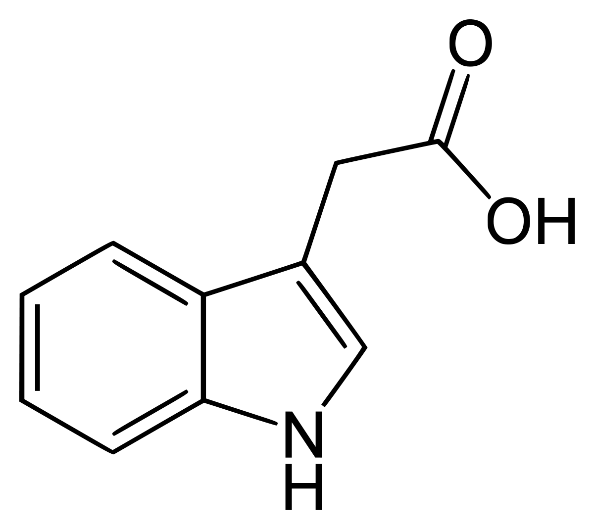
Plant hormones
Hormones are signaling molecules produced in one part of an organism, and transported to other parts of that organism, where it binds to a specific receptor and triggers responses in the target cells

Slide 19
Plant hormones
Some plant biologists prefer the term plant growth regulator instead of hormone because the the definition of hormone as developed by animal biologists is too limiting for describing their activity in plants

Slide 20
Survey of plant hormones:
Auxin
Auxin is responsible for cell elongation and regulating plant architecture
Produced in shoot tips, moves only from tip-to-base (polar transport)

Slide 21
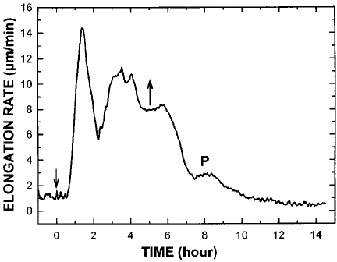
Role of auxin in stem elongation
Auxin is produced in the shoot tip and moves down to the region of cell elongation
stimulates stem elongation at low concentrations, 10⁻⁸ to 10⁻⁴ M
Higher concentrations inhibit stem elongation

Slide 22
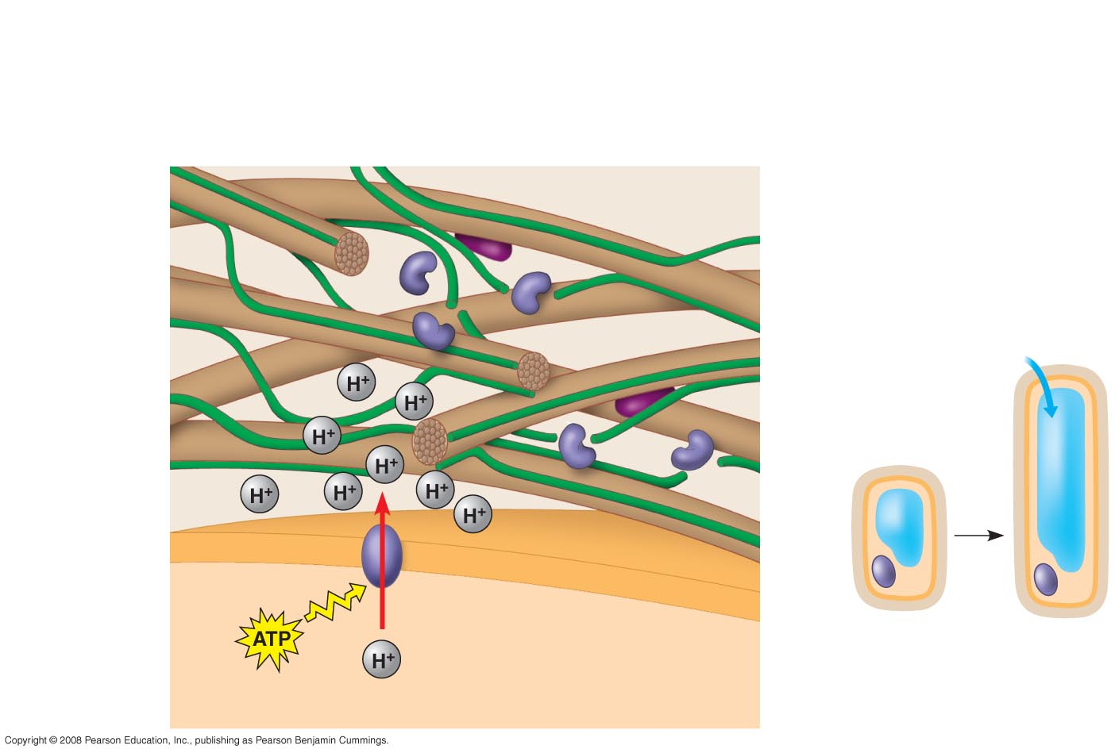
Acid Growth Hypothesis
3
Expansins separate
microfibrils from cross-
linking polysaccharides.
Cell wall–loosening
enzymes
Cross-linking
polysaccharides
Expansin
CELL WALL
4
Cleaving allows
microfibrils to slide.
Cellulose
microfibril
H₂O
2
Plasma
membrane
Cell
wall
Cell wall
becomes
more acidic.
1
Auxin
increases
proton pump
activity.
Plasma membrane
Nucleus
Cytoplasm
Vacuole
CYTOPLASM
5
Cell can elongate.
Notes:
Figure 39.8 Cell elongation in response to auxin: the acid growth hypothesis

Slide 23

Auxin’s role in plant development and architecture

Slide 24
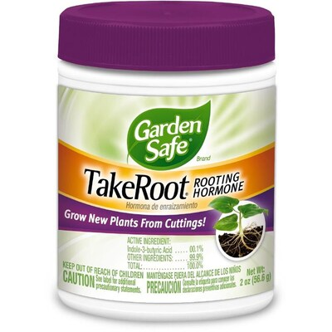
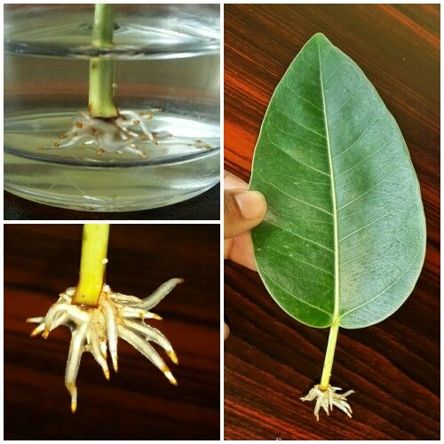
Commercial uses of auxin
In low concentrations, root stimulator
In high concentrations, herbicide

Slide 25
Plant signaling and hormones

Slide 26
Learning goal
Know the plant hormones covered in the lecture and each of their roles in plant growth and development

Slide 27
Cytokinins
Produced primarily in roots, also in embryos and fruits
Three primary effects
Involved in cell division
Control of apical dominance
Anti-aging effects

Slide 28
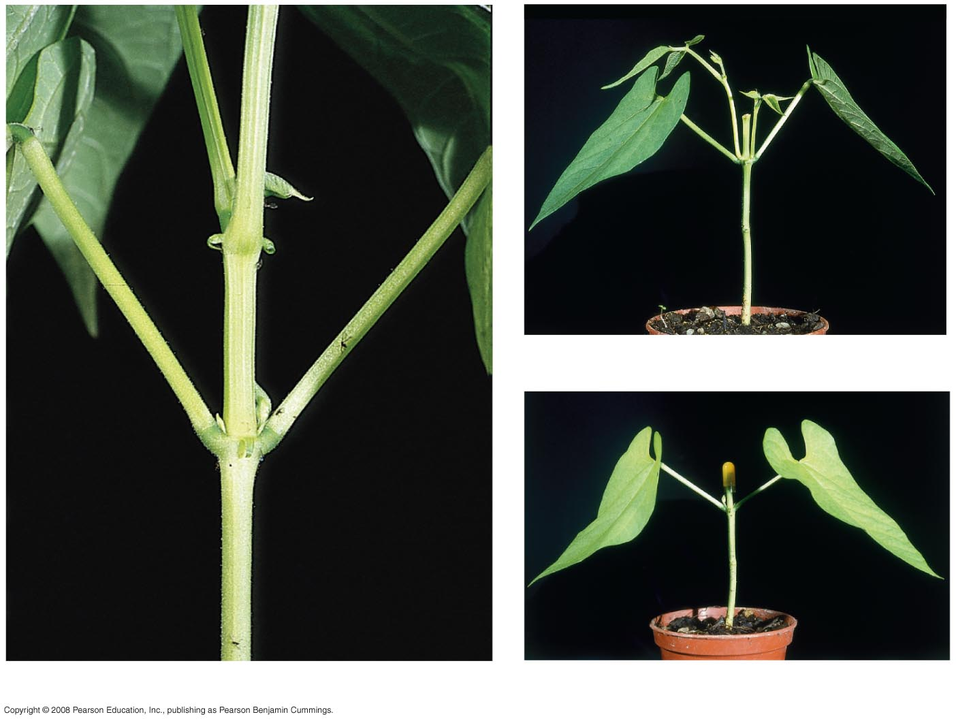
Fig. 39-9
Lateral branches
“Stump” after
removal of
apical bud
(b) Apical bud removed
Axillary buds
(a) Apical bud intact (not shown in photo)
(c) Auxin added to decapitated stem
Notes:
Figure 39.9 Apical dominance

Slide 29
Gibberellins
Produced mainly in young stems and leaves
Stimulate stem and leaf growth by enhancing elongation and cell division
Required for fruit development
Serve as a cue for seed germination

Slide 30
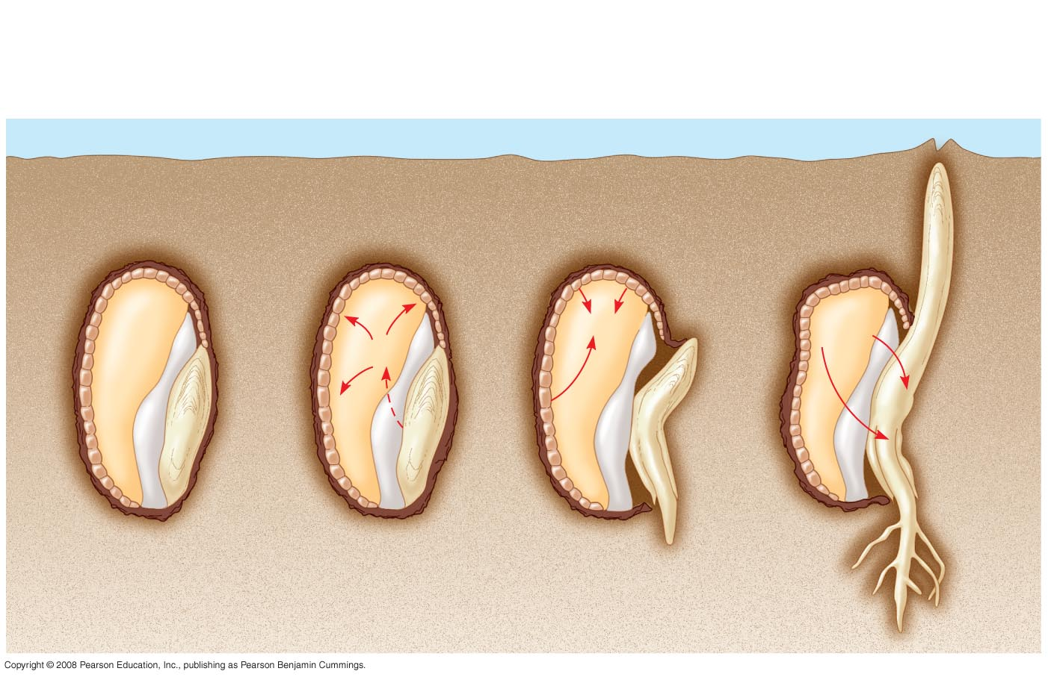
Fig. 39-11
GA promotes seed germination
Gibberellins (GA)
send signal to
aleurone.
1
2
Sugars and other
nutrients are consumed.
Aleurone secretes
α-amylase and other enzymes.
3
Aleurone
Endosperm
α-amylase
Sugar
GA
GA
Water
Scutellum
(cotyledon)
Radicle
Notes:
Figure 39.11 Mobilization of nutrients by gibberellins during the germination of grain seeds such as barley

Slide 31
Abscisic acid ( ABA)
Slows growth, mainly by interacting with other hormones
Contributes to seed dormancy
Contributes to drought tolerance

Slide 32
Ethylene
Plants produce ethylene gas in response to stresses like drought, flooding, mechanical pressure, injury, and infection
Ethylene has many effects, we’ll focus on just four
Senescence
Leaf abscission
Fruit ripening
Response to mechanical stress (triple response)

Slide 33
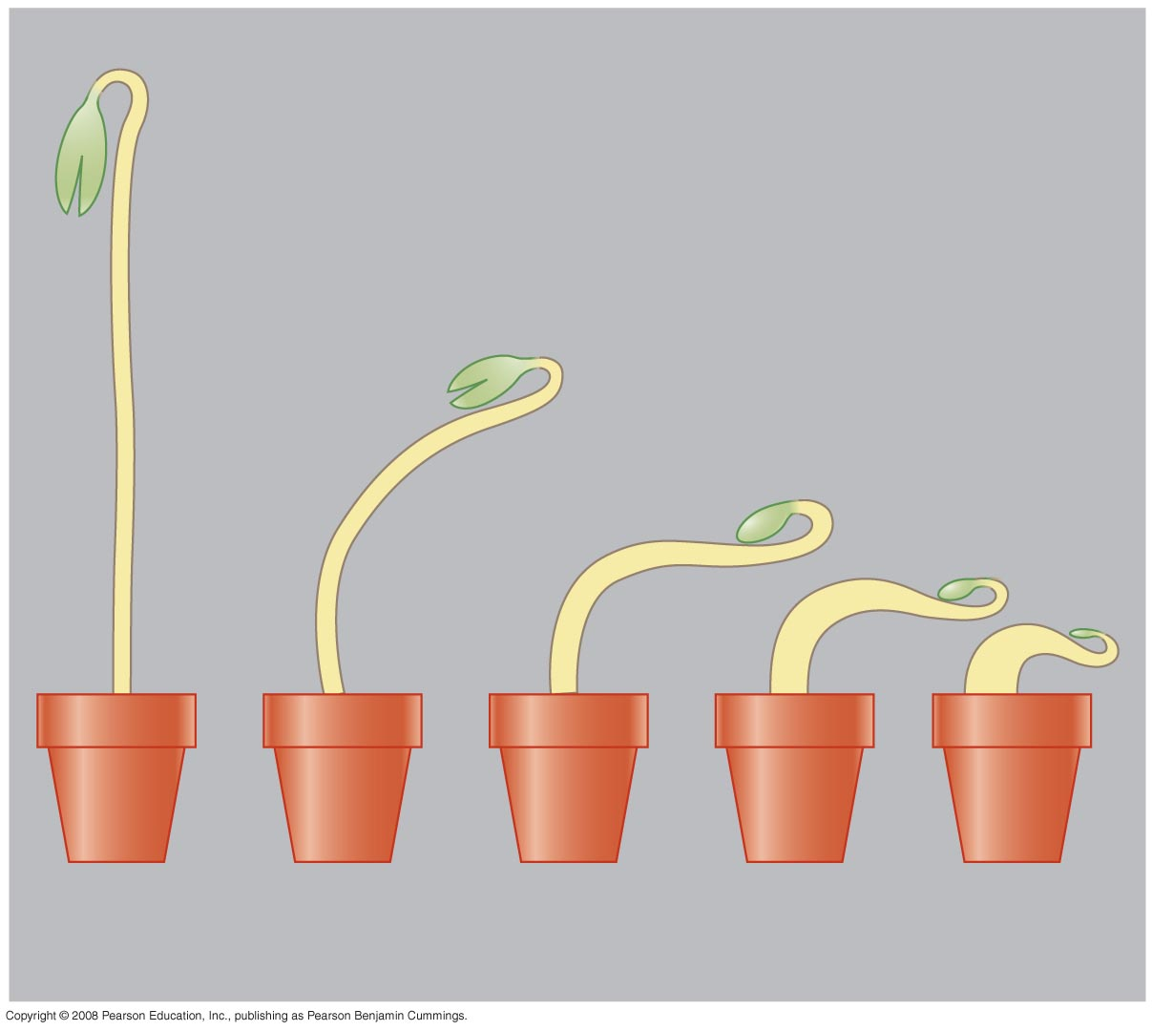
Fig. 39-13
The Triple Response
to Ethylene
0.00
0.10
0.20
0.40
0.80
Ethylene concentration (parts per million)
Notes:
Figure 39.13 The ethylene-induced triple response

Slide 34
Other hormones and their actions
Brassinosteroids - auxin like action (cell elongation and division, leaf abscission)
Jasmonates - defense against herbivores and pathogens
Strigolactones - stimulates seed germination, helps establish root mycorrhizal connections, control of apical dominance

